Slide 1
Geographic Direct Demand Model of Transit Ridership
Raven McKnight
08/11/2020

Slide 2
Background

Slide 3
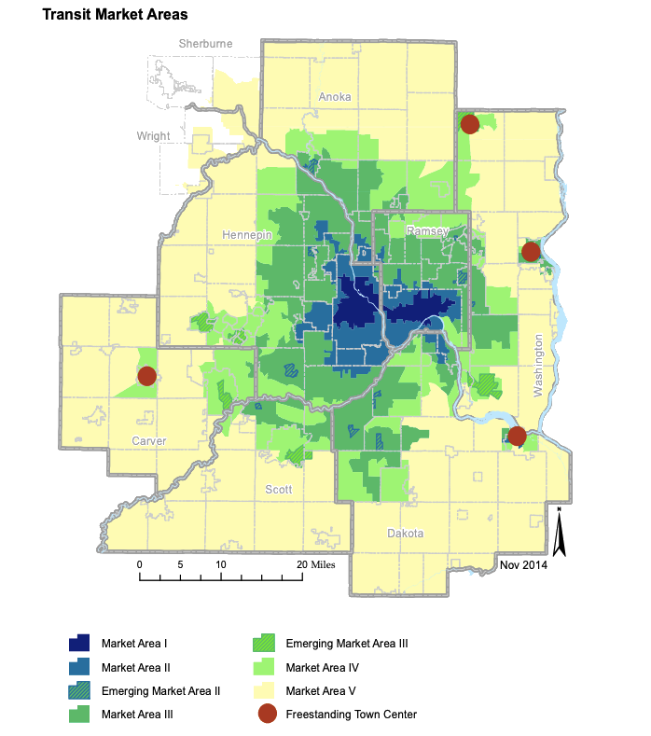
Transit Market Areas
spatial distribution of ridership
how should we allocate service?
communication tool
Transportation Policy Plan

Slide 4
Ridership = 0.65 * Population Density + 0.20 * Employment Density + 0.11 * Automobile Deficit + 0.23 * Intersection Density

Slide 5
Goals

Slide 6
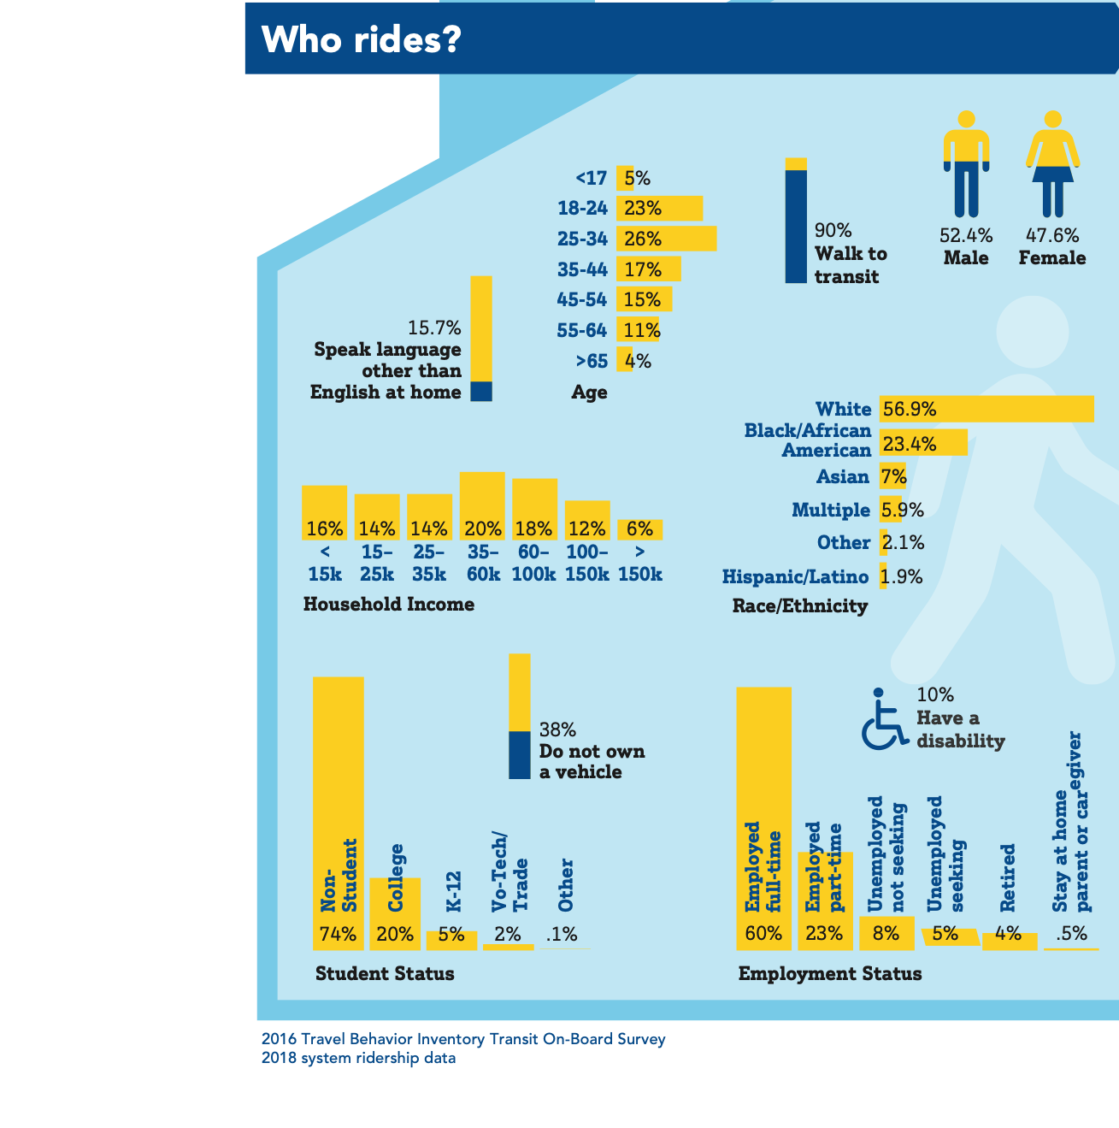
Incorporate more demographic predictors
transit riders tend to be more diverse than background population
leverage what we know about ridership and the region

Slide 7
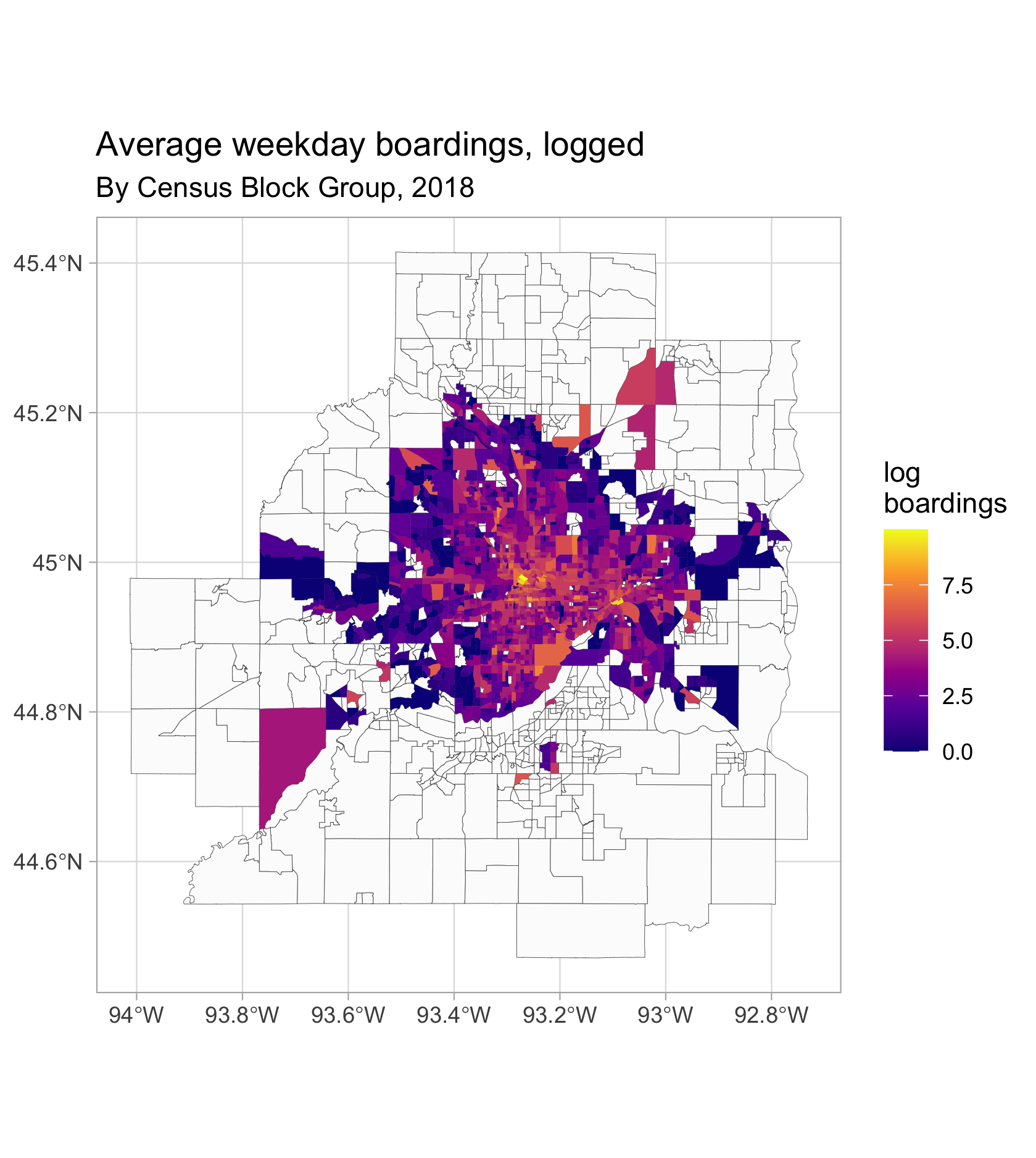
Include spatial information
ridership is inherently spatial!
spatial autocorrelation
statistical methods

Slide 8
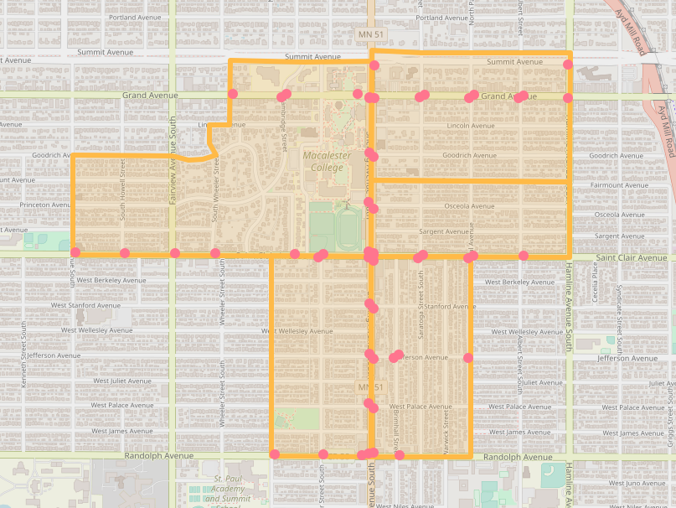
Census geography
census geography tends to be bounded by major roadways
how can we aggregate bus stops to block groups?

Slide 9
Data

Slide 10
Demographics Ridership
2018 American Community Survey (ACS) 5 Year Estimates
2017 Longitudinal Employee Household Dynamic Survey
2018 Automatic Passenger Count (APC)
Response variable Y: average number of weekday boardings per block group

Slide 11
The model

Slide 12
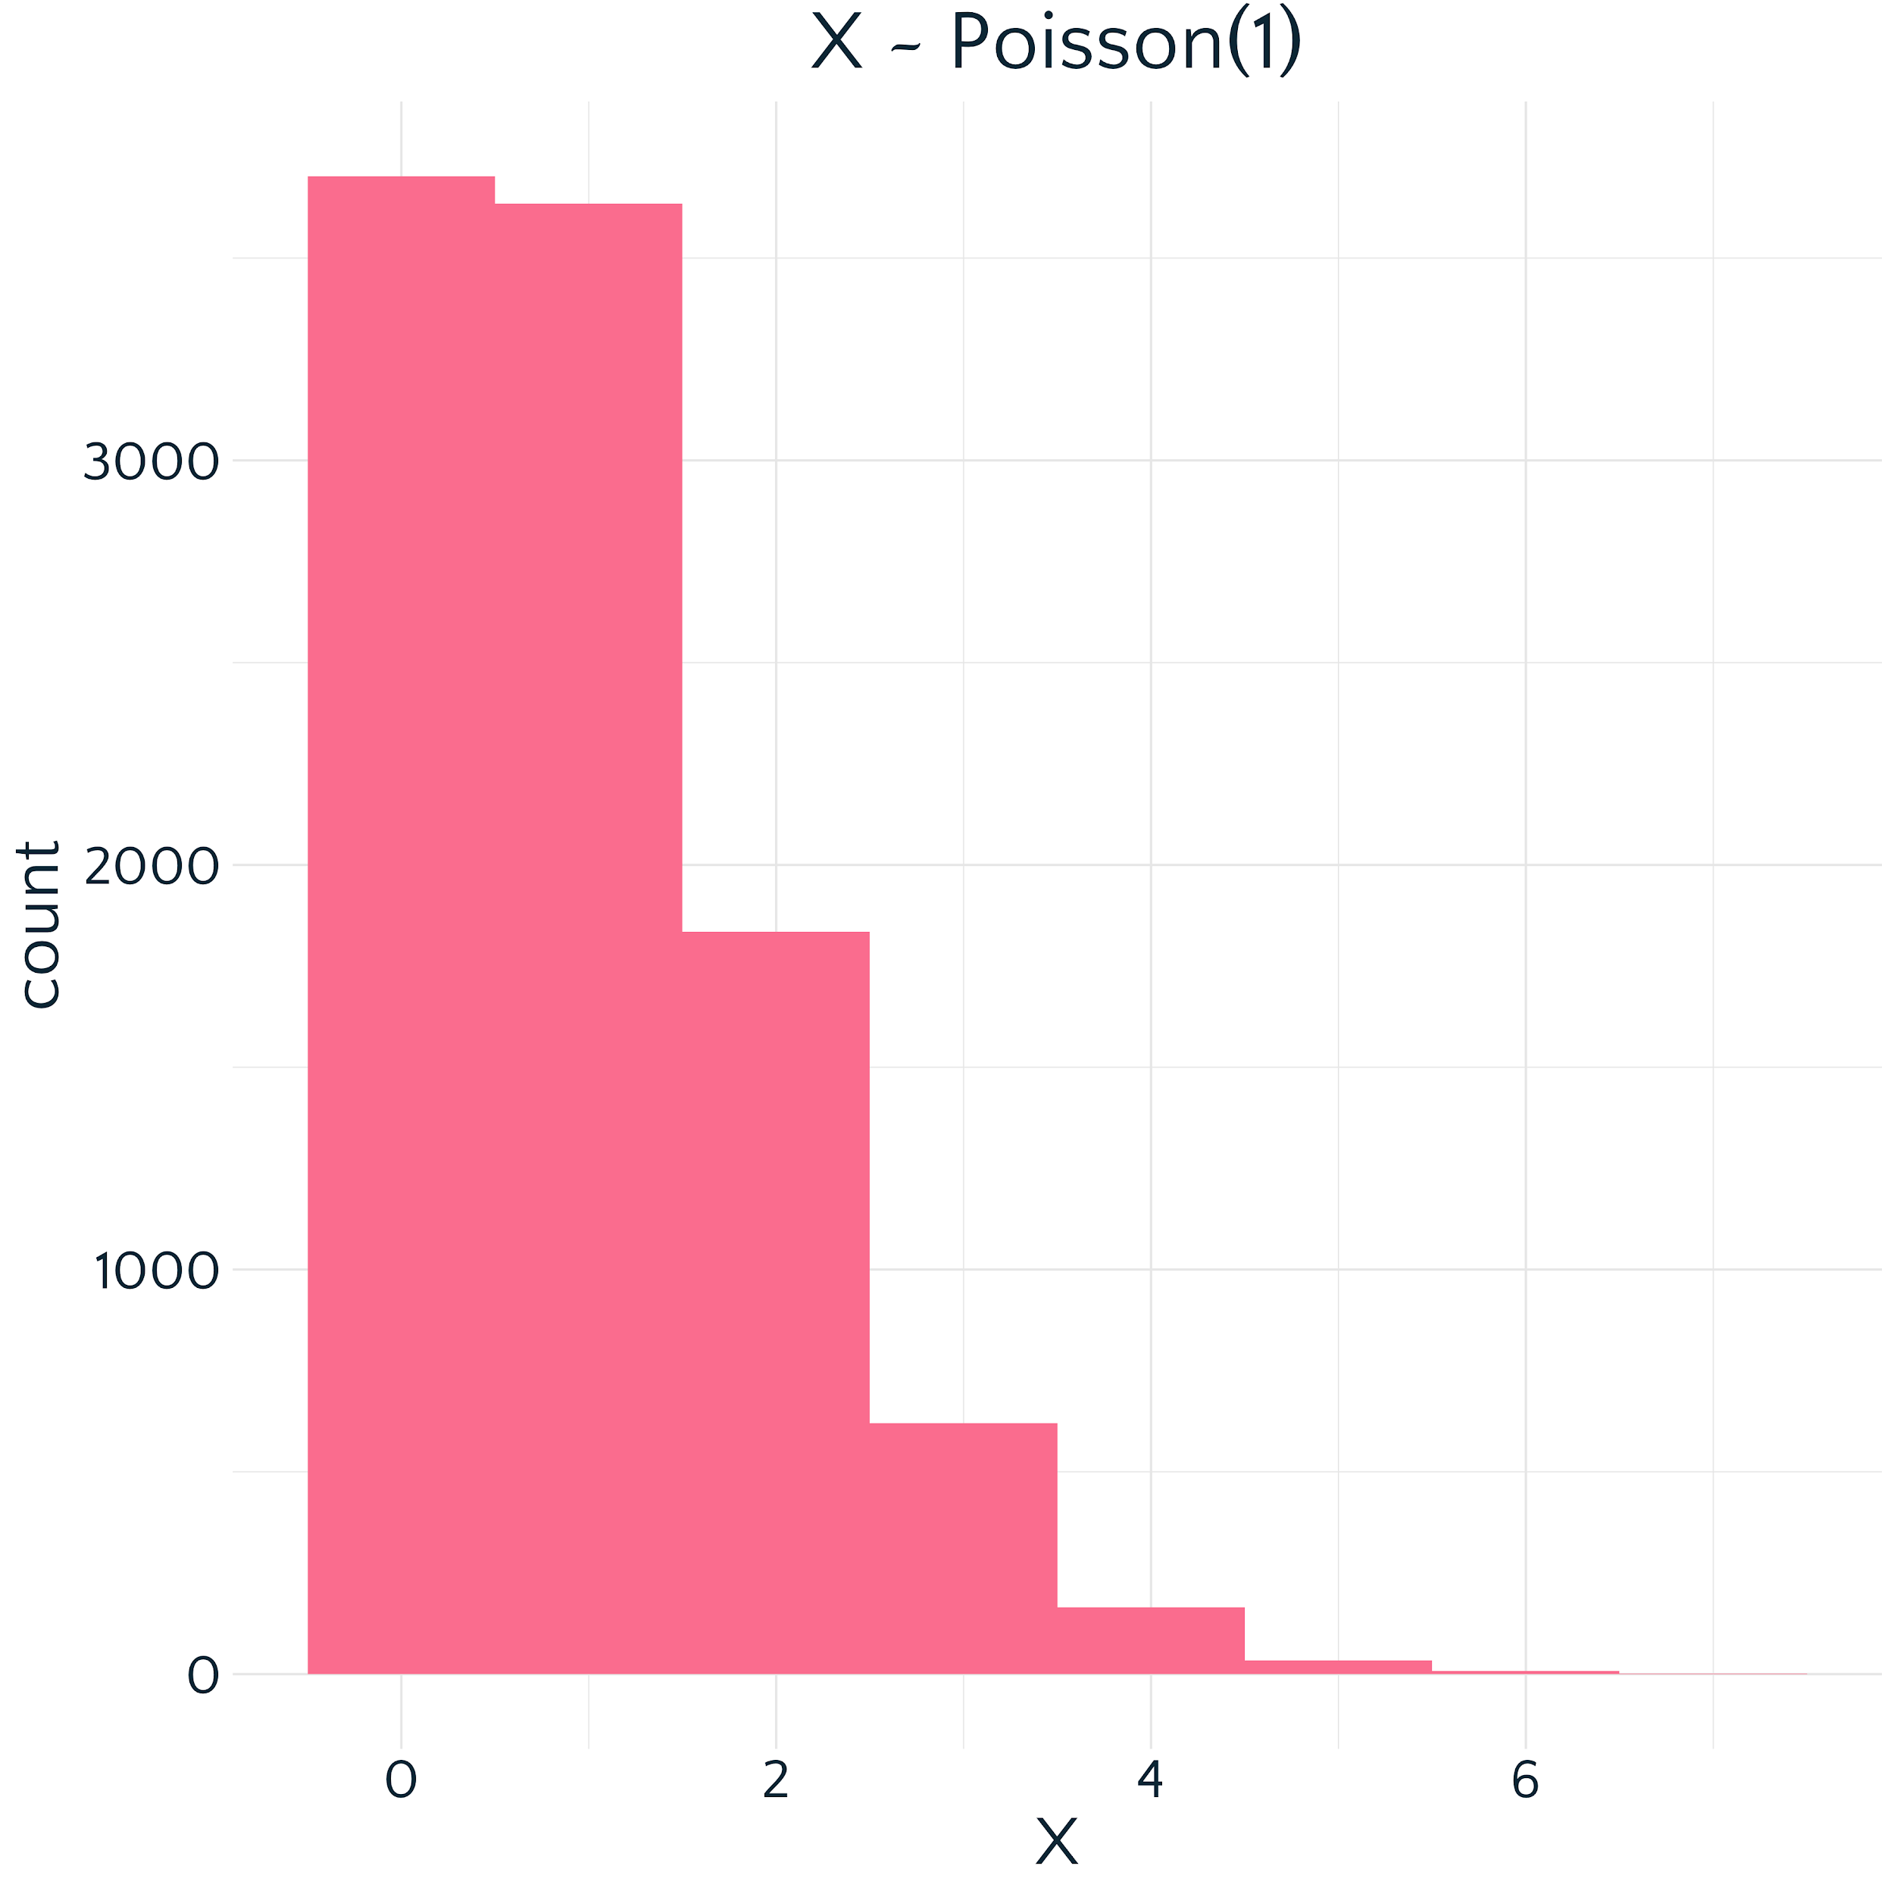
used for count data, or events occurring at a rate

Slide 13
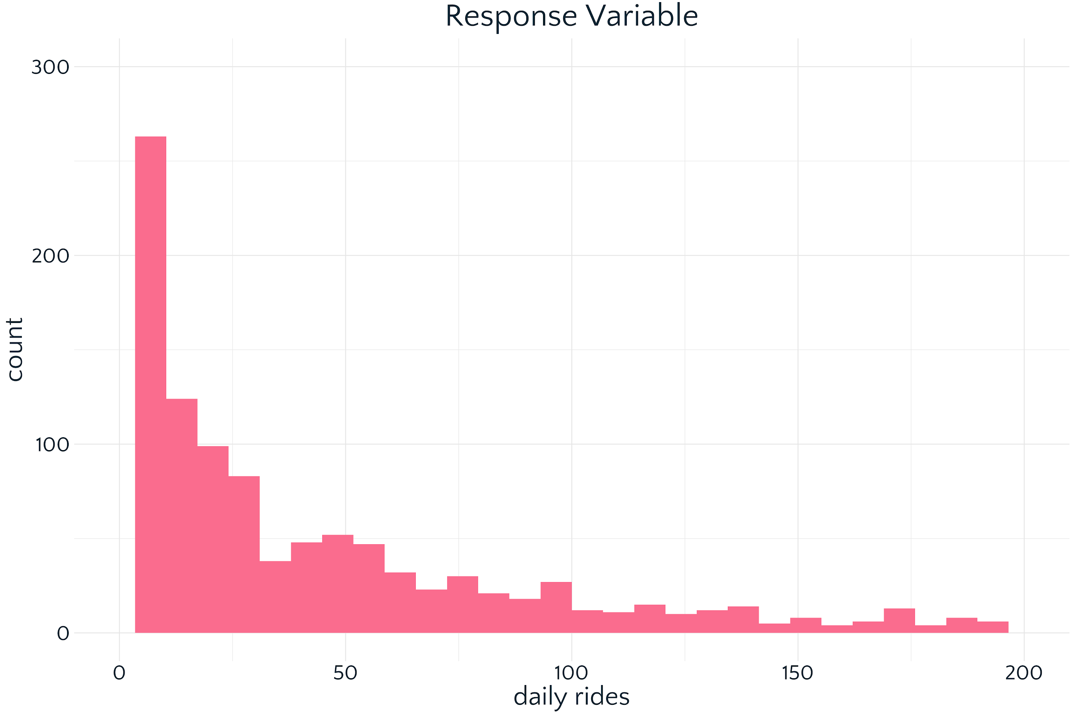
Poisson?

Slide 14
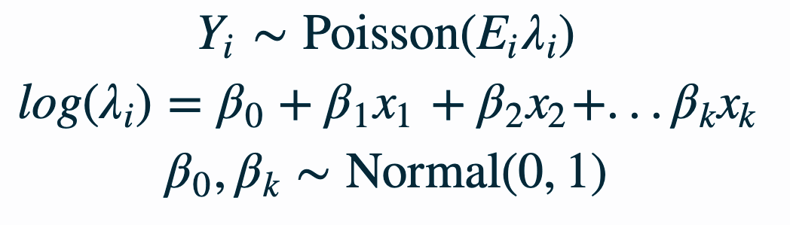
ridership in block group i

Slide 15
offset: number of times a bus stops in block group i

Slide 16
rate

Slide 17
predictors

Slide 18
coefficients to estimate

Slide 19
CAR Model
Conditional Autoregressive Model
Often used in disease risk modeling to smooth noisy count data
Explicitly models spatial and non-spatial structure in errors
“Borrows strength”

Slide 20

2
0
5
how do we estimate this value if we haven’t observed any data?
1
NA
4
4
6
1

Slide 21
2
0
5
CAR priors smooth noisy counts by sharing information with neighbors
1
NA
4
2 + 0 + 5 + 4 + 1 + 6 + 4 + 1
8
= 3
4
6
1

Slide 22
2
0
5
2
0
5
1
NA
4
1
3
4
4
6
1
4
6
1

Slide 23
0
1
0
1
2
3
0
1
1
0
1
0

Slide 24

non-spatial errors + spatial errors

Slide 25
ResultS

Slide 26
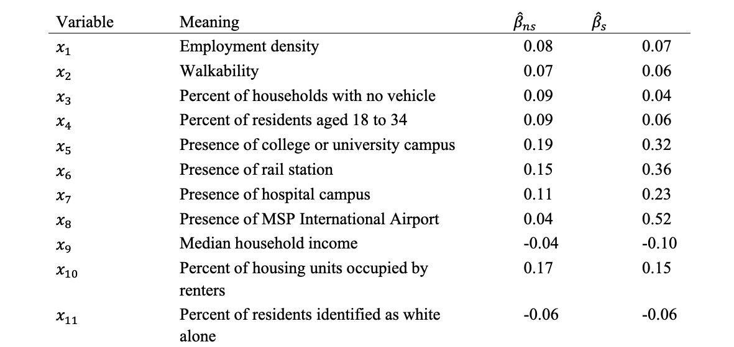

Slide 27
nonspatial vs spatial

Slide 31
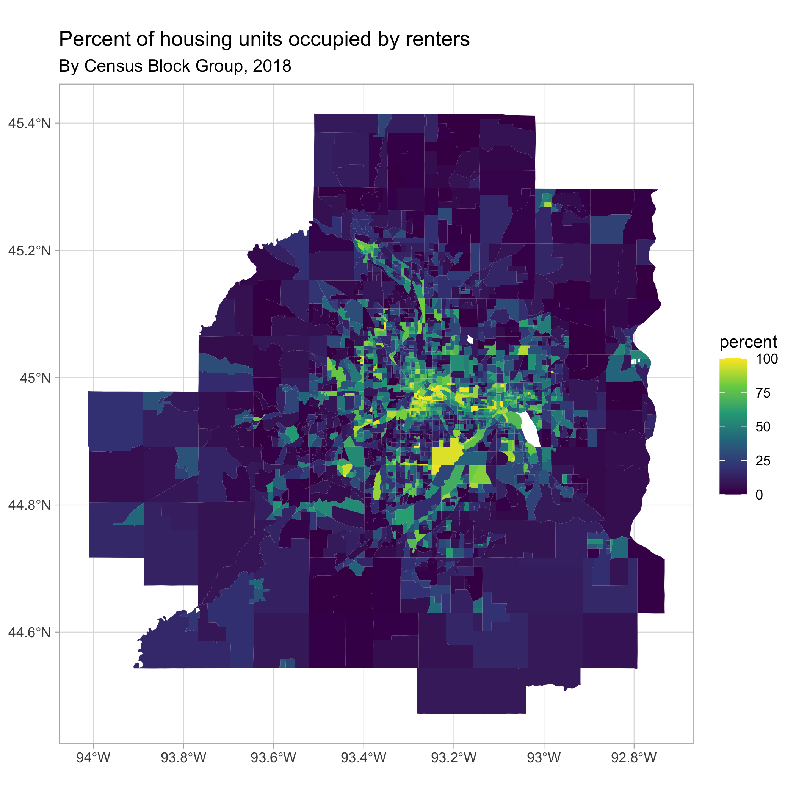
Takeaway: Housing units occupied by renters
most significant positive predictor of ridership in the model!
more tightly clustered than other predictors
related to income, age, student status, etc

Slide 32
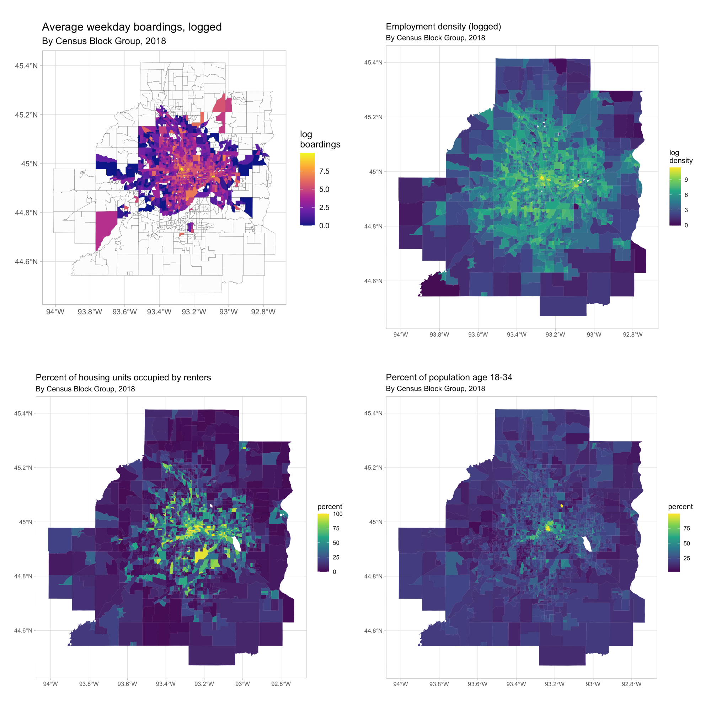
Takeaway: Each predictor tells a different story

Slide 33
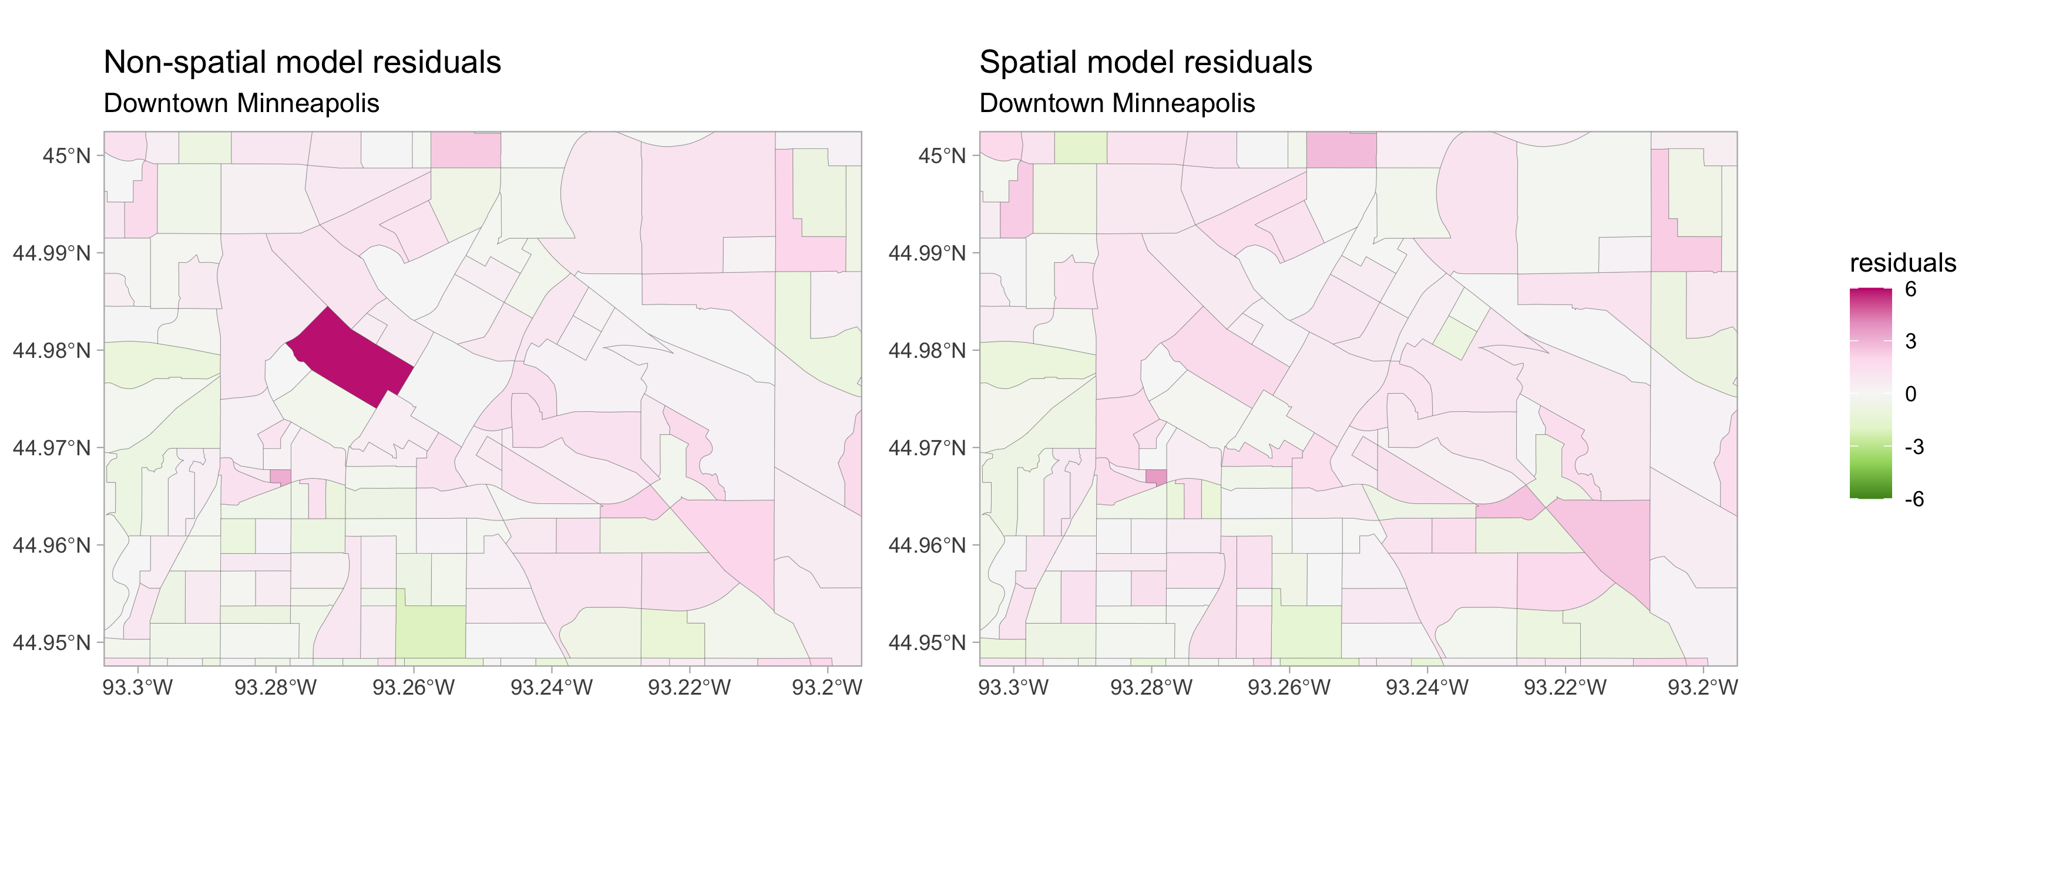
Takeaway: Spatial model gives better fit

Slide 34
Takeaway: Spatial models reveal different patterns
Predictors which are less important in spatial models
Population density
Less focus on ”prerequisite” variables
Predictors which are more important in spatial models
Median household income
nonspatial vs spatial

Slide 35
Conclusions
Key points
Percent renters
Variety of demographic predictors
Spatial model is a better fit
Spatial model can show new patterns
TRB
Share and apply at Metro Transit

Slide 36
Thank yoU!

Slide 37
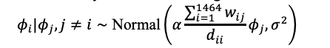

Slide 38
